Slide 1
Online HIV Service Delivery
Benjamin Eveslage, FHI 360/LINKAGES
Notes:
[Name/Title] It is a real pleasure to be with you here today. My name is Ben. I am Technical Advisor for Online HIV Services at FHI 360, and I lead what we call the “Going Online” portfolio.
[About GO] In this portfolio, we support HIV programs in about 20 countries to leverage online and mobile platforms to broaden outreach to previously unreached populations and offer new ways for people to interact and uptake HIV services. And I think this is really the crux of what we are talking about in this panel – new ways to reach and engage people.

Slide 2
WhatsApp Group
Join WhatsApp group discussion: mystep.one/ias
*Your WhatsApp profile and number are visible to fellow group members. You can remove yourself from the group at any time.
Notes:
[Join chat & purpose] Speaking of new ways to engage – take out your phones. We’re opening the option to have a live discussion on WhatsApp let’s connect on a group chat for the purpose of this panel. You can ask questions whenever you want this way, and we can send you links to resources mentioned in the presentations. This is only a supplementary way to engage, we also have the microphones for the discussion, or you can yell from your seat.
[Link] To join the chat, go to a browser and type mystep.one/ias
[Disclaimer] As you join, know that fellow group members can see your WhatsApp profile and you can remove yourself from the group at any time.

Slide 3
Panel topic
Panel 2: Designing and implementing tailored online strategies to engage key populations in HIV services
Notes:
I will moderate this second panel on designing and implementing tailored online strategies to engage key populations in HIV services.
[Manel/ganel] So as you’ve already noticed, it looks like we have a “manel” on our hands… a “man panel”. But I’ll have you know we actually have a quite diverse “ganel” – a gay panel.
[Limitations] I think it’s true to say we’ve learned quite a lot about how to engage gay men online – and I think that’s one reason why we’re all here. But, we still have ways to go before we can truly tailor and adapt these approaches for the diverse context and needs of key populations globally.
[Contribute] We also have you all here! In the discussion and through the group chat, please contribute your added experience, perspectives, and questions.
[Client flow framework] I will take a moment now to illustrate a framework for our presentations on HIV service delivery. The framework follows the client’s journey through HIV services, and we have three main steps of this framework.

Slide 4
1. Online Outreach Approaches
Notes:
First are the online outreach approaches. That is… how an HIV program connects with key populations online. At LINKAGES we’ve outlined three approaches:
[Click] The most common and well-documented approach is social network outreach, shown here in the orange box. This is where a person reaches others in their online social network to help them access HIV services. At LINKAGES we call this a 2nd generation approach for KP HIV outreach. It was developed in the early 2000s mainly in the form of outreach workers going online after a decade or so of physical network and hotspot-based outreach.
The second and third approaches include, social influencer outreach and social profile outreach. [Click] Influencers can be a popular person, brand, or campaign with an established online following among the target audience. They can promote, popularize, and reduce barriers for HIV services.
[Click] Profile outreach is focused online advertising. It leverages ad platforms like Facebook, Twitter, Google search ads, and dating applications to ensure that information about HIV services are shown to the right audience.
[3rd gen] At LINKAGES we call these last two a 3rd gen approach. They are only recently being used by HIV programs and are not standardized outreach approaches within most HIV programs, even if they have become the foremost marketing techniques for private sector trying to reach young people.

Slide 5
2. Linkage Modalities
Notes:
Step 2 are methods for linking clients to HIV services. The linkage modality answers the twin questions of: How are the populations who are reached online linked to HIV services, and how is this referral tracked? These are the golden questions for online HIV programs. And today we have three golden answers for you.
[Click] Offlining is where clients reached online are offered to meet offline, maybe at a safe public space or community center to then be referred or accompanied to an HIV service facility.
[Click] E-referral: is when clients are referred to HIV service sites by simply sending them directions on how to get there and may include a picture with referral details/code that the client and bring to the facility on their phone. Protocols are also required at the service sites to collect e-referral codes or ask clients how they were referred.
[Click] Appointment booking: may come in the form of a website or app that allows clients to find nearby HIV service sites and select a clinic, set of services, and date and time for appointment. Clinics can use the same tool to accept appointments and mark when clients arrive for their appointment.

Slide 6
3. Services and Facilities
Notes:
The third item that our presenters will touch on, is the significance of the actual services and facilities.
[click, click, click] Community and KP-led health centers, public health services, and private health services, are some of the options. These are not necessarily exhaustive, but are illustrative of how HIV programs can expand their referral network to offer what clients want.

Slide 7
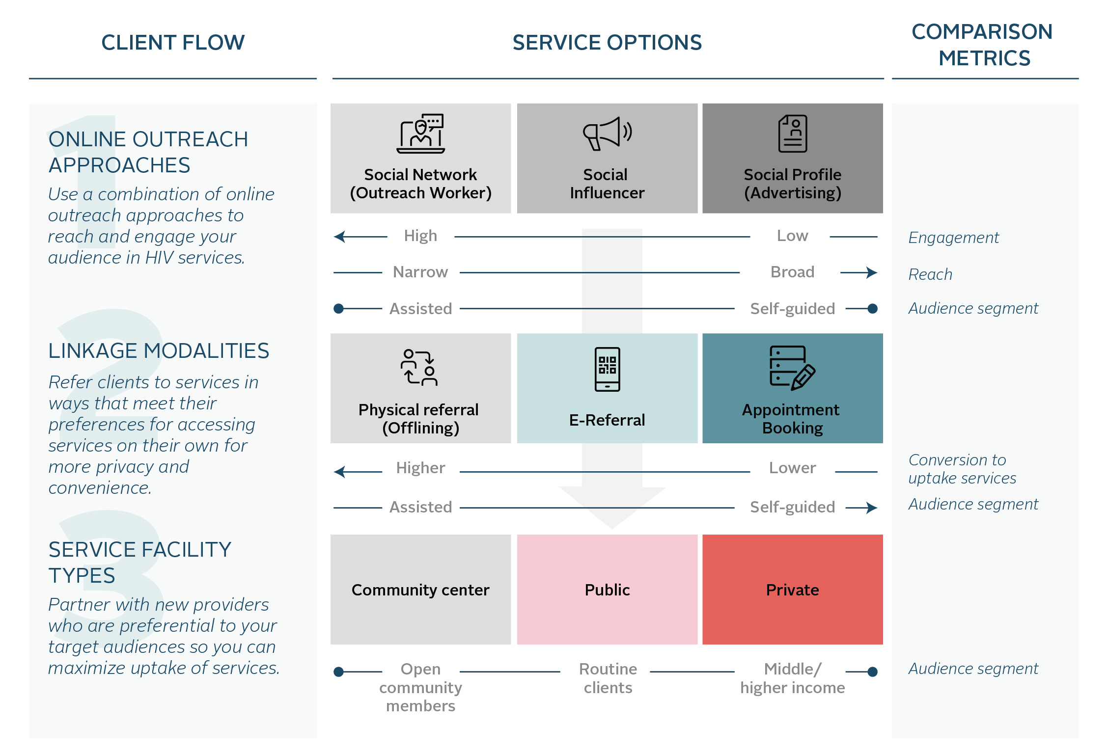
Client Flow
Notes:
Together, these 3 steps create for LINKAGES the initial client flow for online HIV services. Not included here are methods of re-engaging clients over time.
[Differentiation] This simple diagram has been powerful tool for us to develop a logical path from start to finish that meets the context of local partners and preferences of the target audience. Each of our presenters will touch on these aspects and note how they protect client safety and privacy.

Slide 8
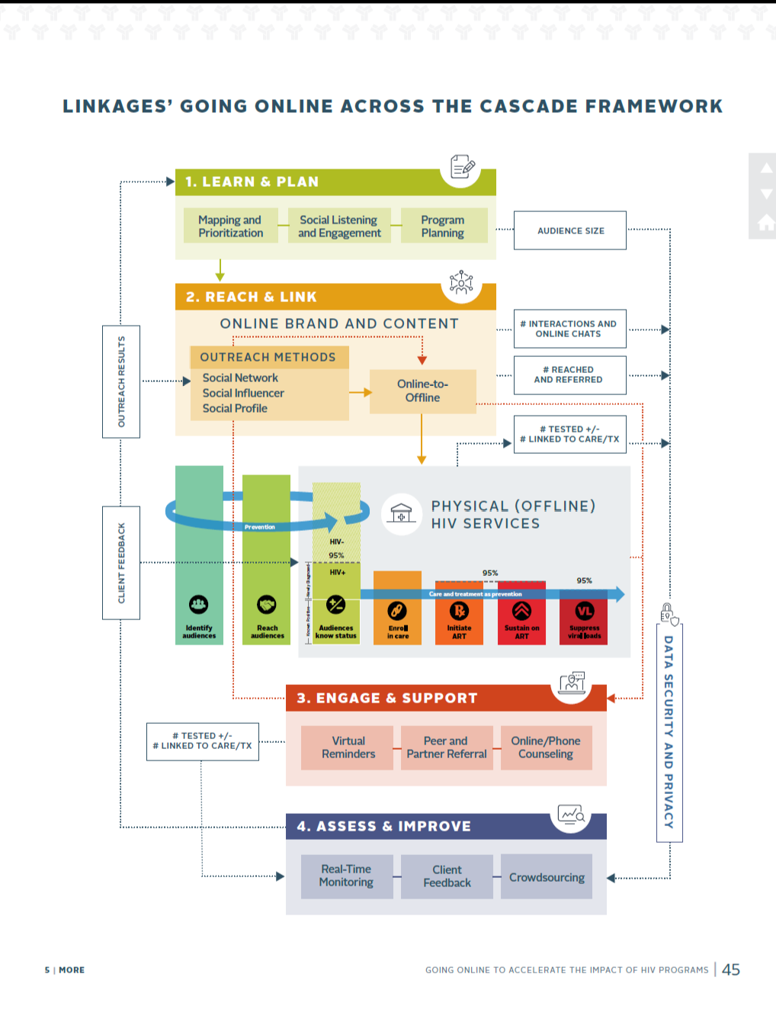
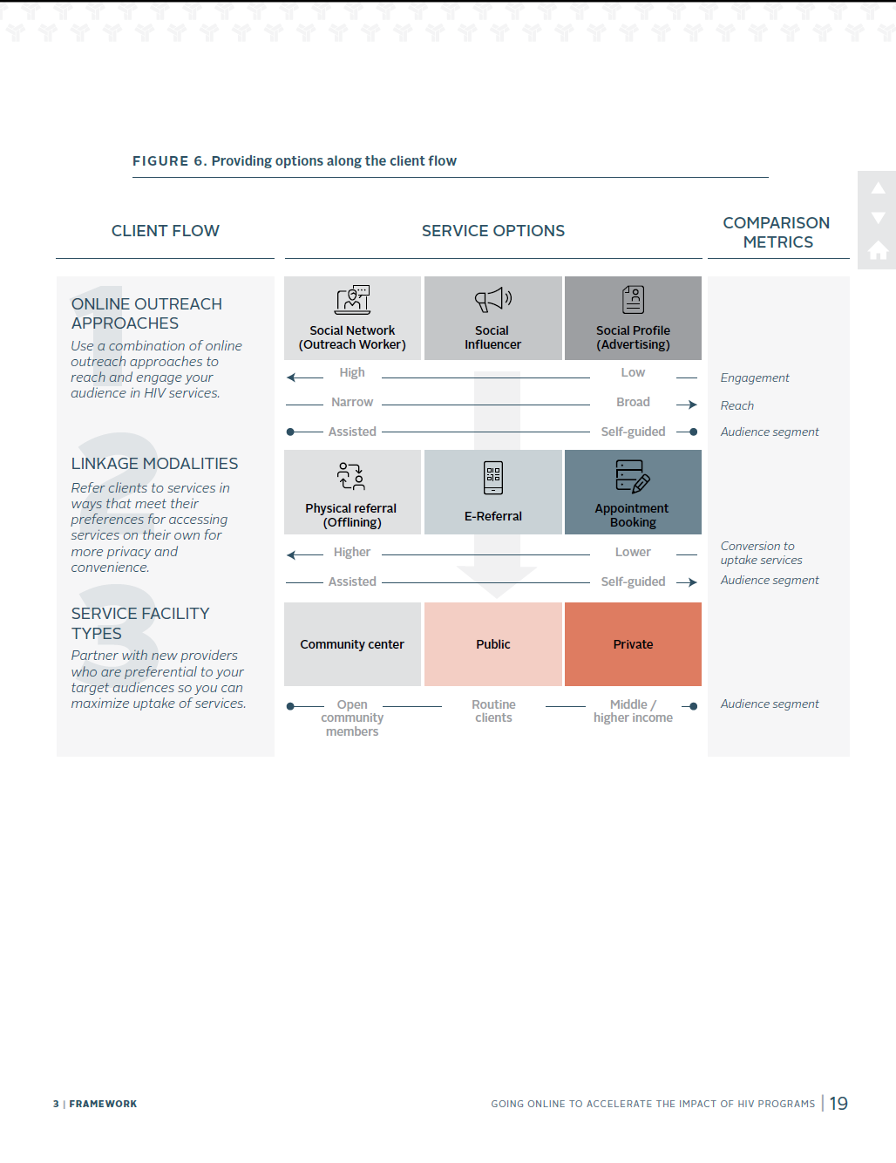
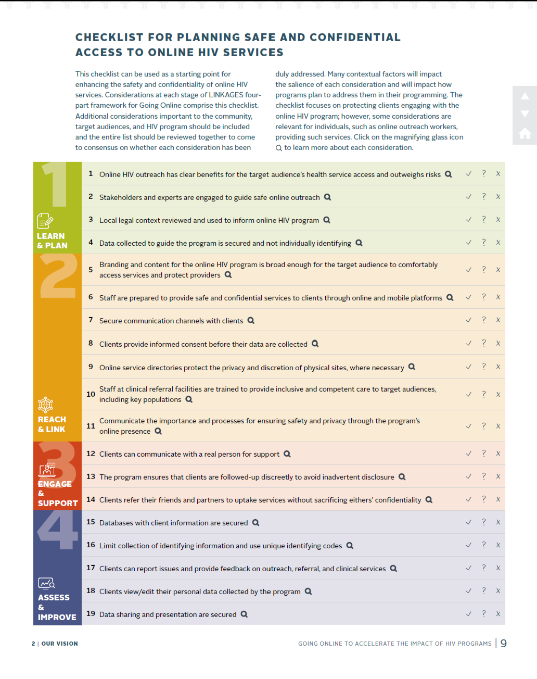
More Information
Questions? Check out LINKAGES vision for Going Online and related technical briefs at FHI360.org/GoingOnline
Notes:
Ok before we get into the presentations, if you are interested to learn more about this client flow, programming guidance, safety and security tips, you can find these explained in LINKAGES vision for Going Online to accelerate the impact of HIV programs and 5 related technical briefs. Then jump to fhi360.org/GoingOnline

Slide 9
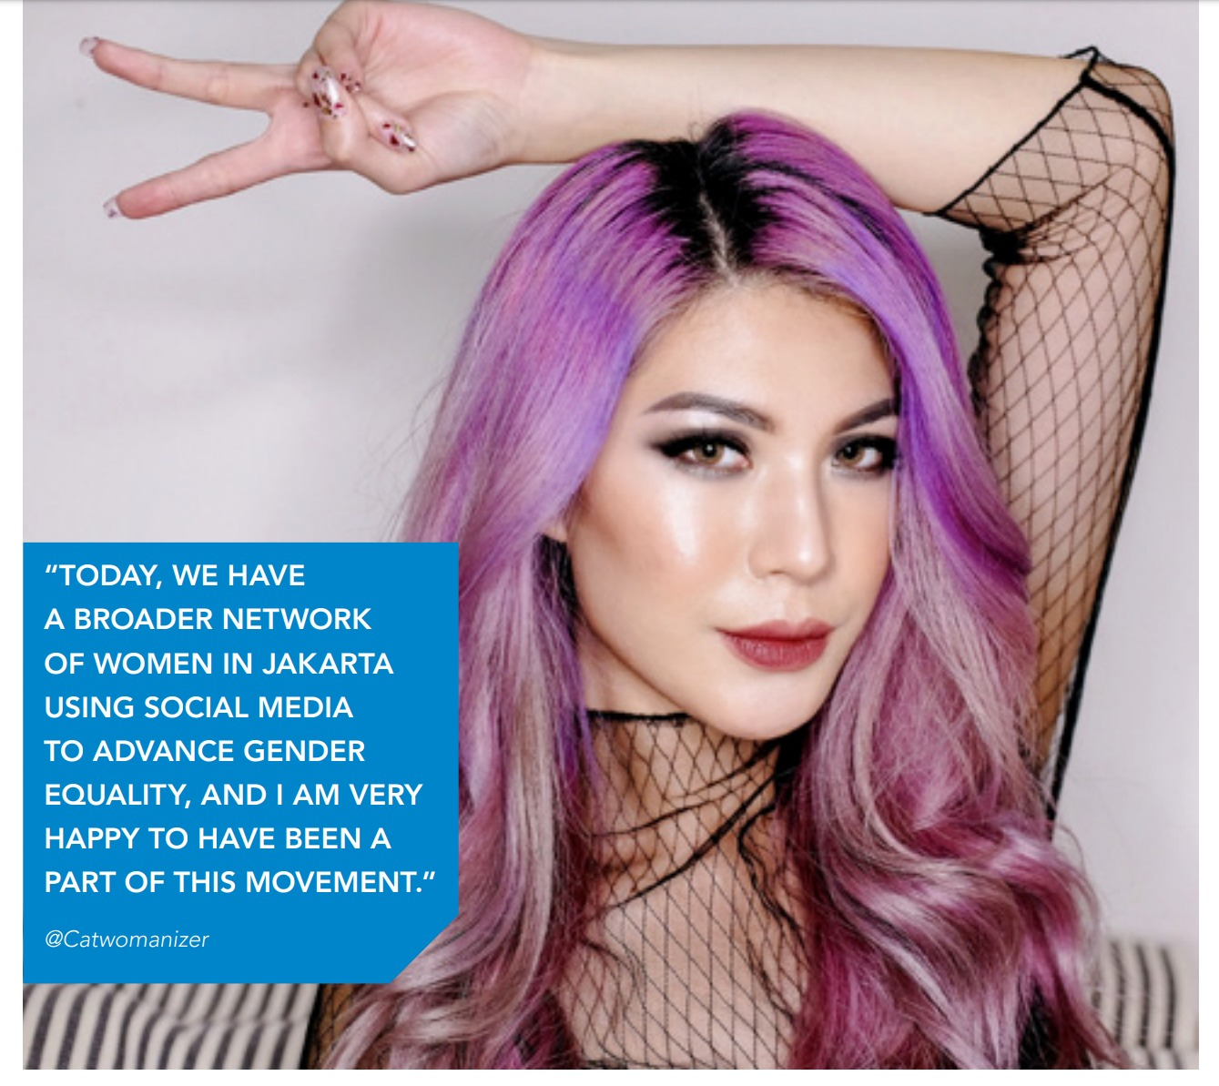
Featured in UNAIDS AIDS Update Report (page 39-45)
Notes:
You may have also noticed some of this featured prominently in the 2019 AIDS update report, available on UNAIDS.org homepage.

Slide 10
To help us dive into the topic…
Abrahim Simmonds
Technical Officer, LINKAGES
(Kingston, Jamaica)
Denis Nzioka
Kenyan LGBTQ and sex work activist
(Nairobi, Kenya)
Inad Rendon
Programmes Manager, APCOM (Bangkok, Thailand)
Alex Garner
Senior Health Innovation Strategist, Hornet (San Francisco, USA)
Notes:
[Presenters, regions, timeline] To get our discussion going we have 4 presenters who will each focus their remarks on unique online strategies for engaging people in HIV services. We have examples from Asia, Africa, and the Latin America/Caribbean regions. Each will have 8 minutes, and end with hopefully 20 minutes for open discussion.

Slide 11
1. Scaling and standardizing community-based online HIV outreach in Jamaica
ONLINE OUTREACH APPROACHES
LINKAGE
MODALITIES
SERVICES AND FACILITIES
Notes:
Abrahim will focus on approaches along the left-hand side of this client flow, which are more targeted, narrow approaches, but those that also allow for greater individualized engagement and support for clients.

Slide 12
2. Driving demand for HIV services through the TextXXX social media campaigns in Southeast Asia
ONLINE OUTREACH APPROACHES
LINKAGE
MODALITIES
SERVICES AND FACILITIES
Notes:
Inad will highlight the 3rd gen approaches of online outreaches as part of a larger set of demand creation campaigns in SE Asia.

Slide 13
3. HIV services a click away! Online booking in Kenya
ONLINE OUTREACH APPROACHES
LINKAGE
MODALITIES
SERVICES AND FACILITIES
Notes:
Denis is himself a social media influencer, and will focus on that method of online outreach, but primarily take us through the linkage mechanism of an online appointment booking platform as used in a new service delivery approach by LINKAGES in Kenya.

Slide 14
4. Queerly connected: Partnering with apps to improve MSM health
ONLINE OUTREACH APPROACHES
IN-APP FUNCTIONS
LINKAGE
MODALITIES
SERVICES AND FACILITIES
BROADER HEALTH NEEDS OF GAY MEN
Notes:
Alex will help us wrap up by also allowing us to think outside the box. He will be presenting on approaches that leverage online social networks, but also specific in-app functions that allow users to access information and services. His unique perspective will also take us outside the typical HIV programmers world to better connect and appreciate our target audience’s broader health needs.

Slide 15
Scaling and standardizing community-based online HIV outreach in Jamaica
Abrahim Simmonds, FHI 360
Notes:
Abrahim Simmonds is a Technical Officer for the LINKAGES Project in Jamaica. He supports the implementation of ICT-related activities that help to extend the reach of services to key populations mainly in Jamaica, while providing technical assistance to programs in Suriname, Barbados and Trinidad and Tobago. An Associate Fellow of the Royal Commonwealth Society, Abrahim has worked with several youth-led organizations focusing on sexual and reproductive health and empowerment. He is also a trained social worker and a recipient of the Queen's Young Leader Award, conferred by Queen Elizabeth II in 2017.
Title: Scaling and standardizing community-based online HIV outreach in Jamaica

Slide 16
Driving demand for HIV services through the TextXXX social media campaigns in Southeast Asia
Inad Rendon, APCOM
Notes:
Inad Rendon is the Programmes Manager of APCOM based in Bangkok, Thailand. With a legal background, his area of expertise is on human rights, legal environments and their links to growing HIV rates. He has been with APCOM since 2013. His role includes overseeing and provide strategic directions to APCOM's portfolio under the programmes unit including (a) research and strategic information; (b) demand generation and behavioral change communication; (c) capacity building and technical assistance; and (d) human rights and SOGIESC.
Title: Driving demand for HIV services through the TextXXX social media campaigns in Southeast Asia

Slide 17
HIV services a click away! Online booking in Kenya
Denis Nzioka, Activist
Notes:
Denis Nzioka is a sexual, and gender minority activist-author and journalist with a particular focus on LGBTIQ and Sex Worker communities in Kenya, and in Africa.
Title: HIV services a click away! Online booking in Kenya

Slide 18
Queerly connected: Partnering with apps to improve MSM health
Alex Garner, Hornet
Notes:
Alex Garner is the Senior Health Innovation Strategist at Hornet, the gay social networking app. He works to create and develop health-related content, programming, and research while cultivating an online community where users have the resources to make informed decisions about their health. He has over 20 years of experience working as a community organizer, as a HIV-positive youth advocate, concentrated on issues of concern to gay men of color. Mr. Garner has organized communities to respond to the needs of LGBT people, people of color, and individuals living with HIV. He founded and managed a national HIV magazine.
Title: Queerly connected: Partnering with apps to improve MSM health

Slide 19
Panel 2: Discussion
Benjamin Eveslage, FHI 360/LINKAGES

Slide 20
Closing Remarks
Michelle Rodolph, WHO

Slide 21
Stay connected with LINKAGES
Follow LINKAGES on Twitter: www.twitter.com/LINKAGES project
Like the project on Facebook: www.facebook.com/LINKAGES project
Subscribe to the LINKAGES blog www.linkagesproject.wordpress.com
Subscribe to The LINK, LINKAGES’s quarterly project e-newsletter
Check out LINKAGES’s quarterly research digest

Slide 22
Acknowledgments
A special thanks to the satellite co-sponsors…

